Slide 1







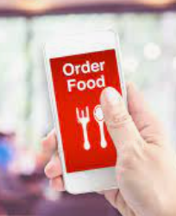
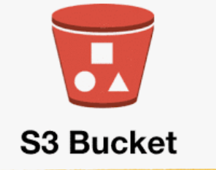
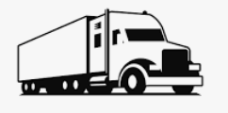
PH -> DL – order, sale, driver route
PHOnl -> PH – order
Apps -> PH – order
PH –> apps – order wait time
PH ->PHOnl – order wait time
Automatic Inventory stats, Inventory order confirmations
Business Reporting Frontend
Order placed origin
Order amount
Inventory sold
PHOnl -> order, location of service
PH -> PHOnl time estimate
Reporting API
Daily backups in document form for eventual reload
DL orders inventory automatically
Apps -> PH API - Order information, place of order
PH API –> Apps – confirmation , est. time of pick up
Local fulfillment centers

